Slide 1
Traffic Tracking Using Computer Vision Brian Joseph & Connor Galvin MATH 4025 – Applied Mathematics Capstone Professor Lee-Peng Lee April 17, 2019

Slide 2
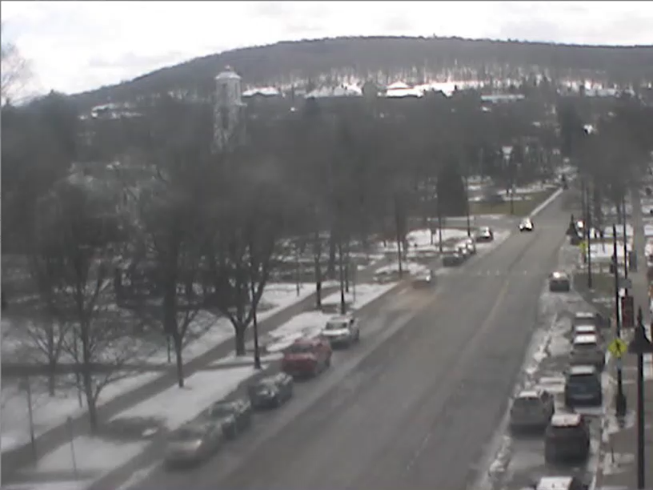
Introduction
Motivations
How many vehicles pass through a street on any given day?
What time of day has the most traffic?
How does our model compare to human judgement?
Goal
Count the number of vehicles that pass in either direction of webcam feed
Colgate University in Hamilton, NY

Slide 3
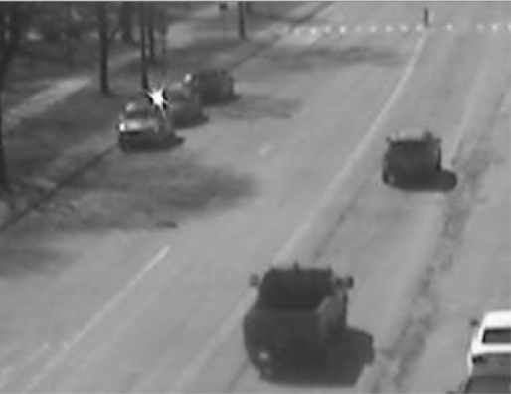
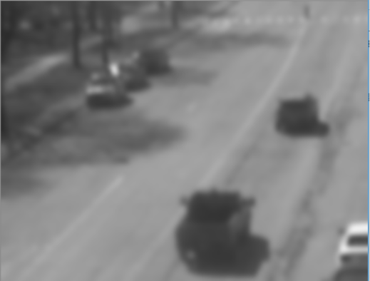
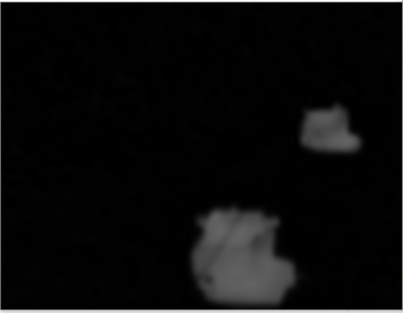

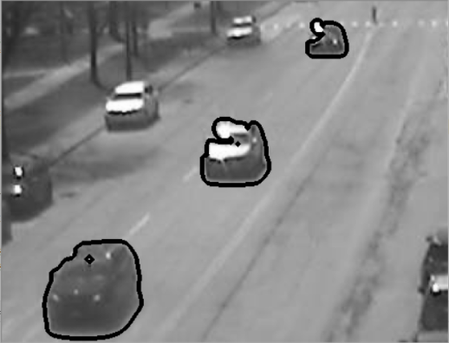
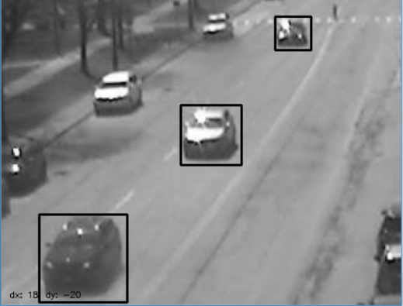
Pipeline
Background Subtraction
Threshold
Gray
Blur
Contour
Bounding Box

Slide 4
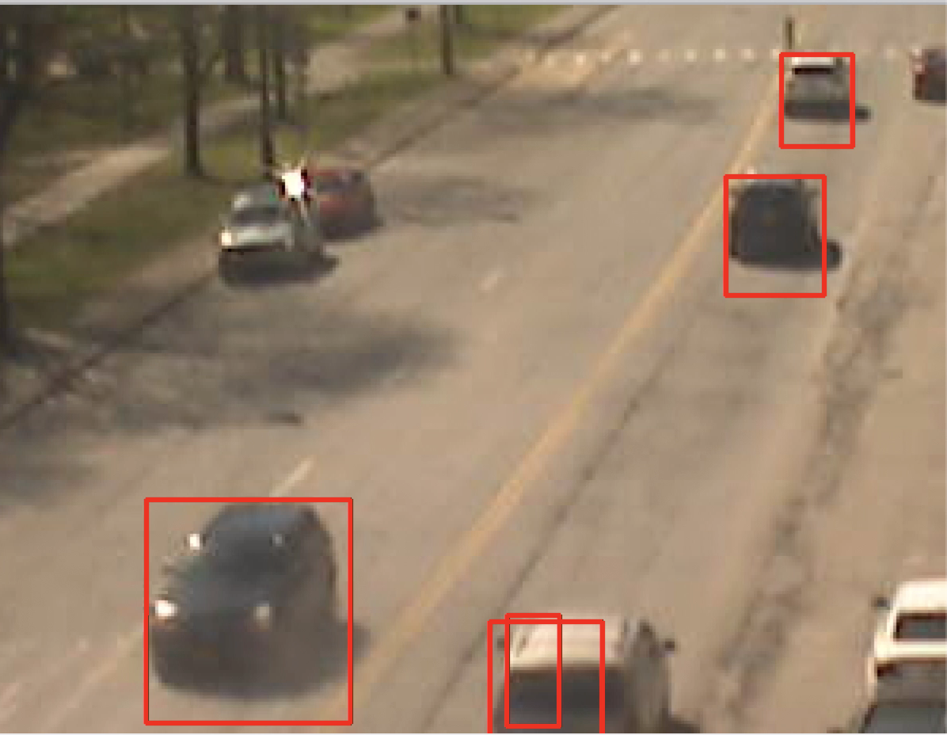
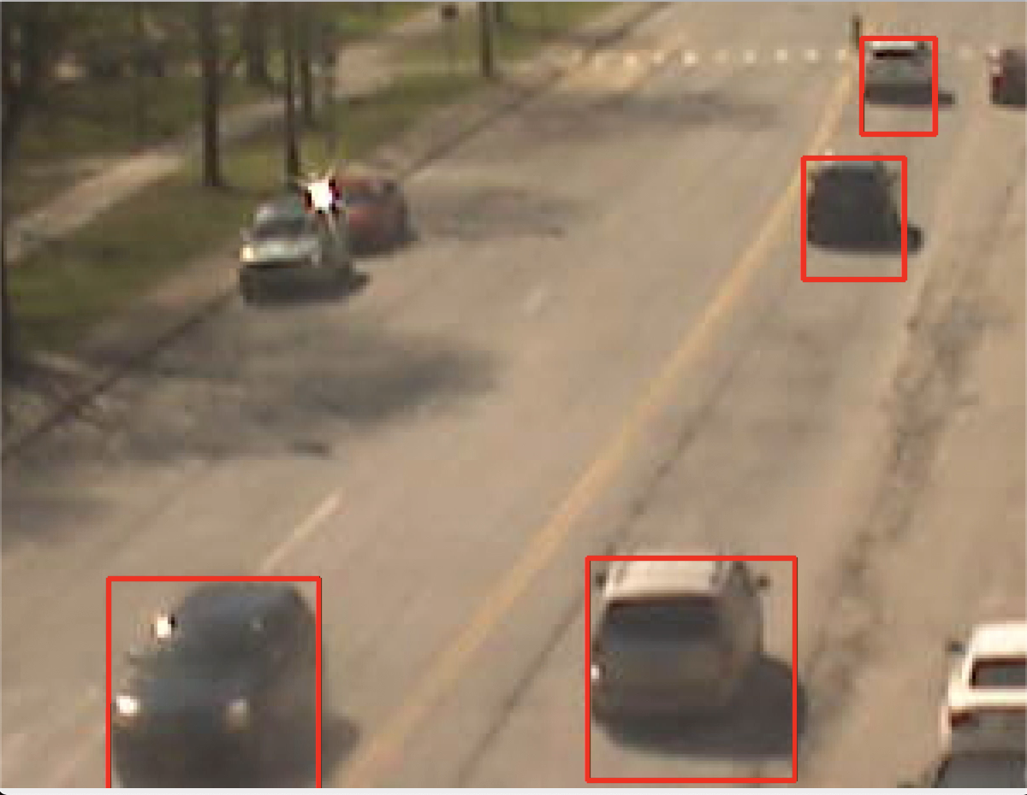
Contour Heuristics
Size
Precision & Recall
Age
Number of total Contours
Direction
Proximity

Slide 5
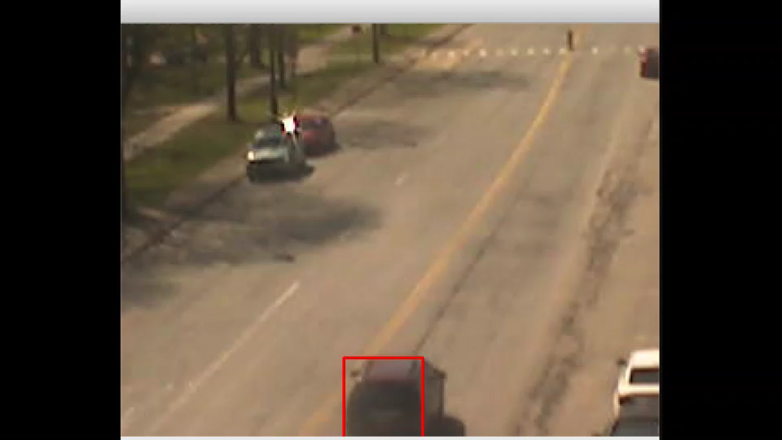
Results

Slide 6
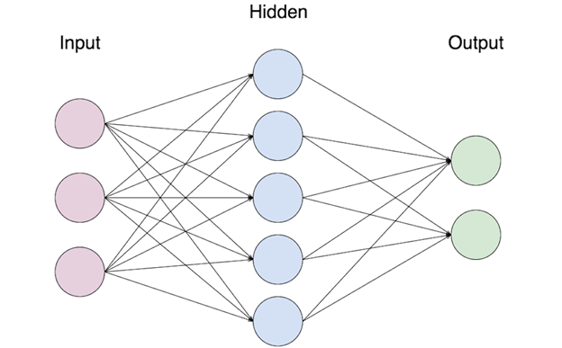


Significance & Future Work
Problems
Rain
Stopping card
Pedestrians
Trucks
U-turns / erratic driving
Solutions / Next Steps
Generalize work to other feeds
Train a model to identify number of cars
Apply algorithm to general object tracking

Slide 7
Thank You!
Questions?

